Slide 1


FINANCIAL INTELLIGENCE IN
RESIDENTIAL REAL ESTATE AGENCY BUSINESS

Slide 2


Astute real estate agency managers know how to analyse the profit status of their business. They know the level of fee revenue and the underlying activity required to achieve their desired and realistic profit outcome - and they set actions to achieve those outcomes.
“What you can’t measure, you cannot manage. What you can’t manage, you cannot change.”
Notes:
Emphasise the need for agency owners/managers to know which numbers to monitor and where the get that information – if you don’t know, refer to your accountant.

Slide 3


INDUSTRY OBSERVATIONS

Slide 4
Brand – Automation - People
REAL ESTATE sales & management BUSINESS
Accountability
Perception = Reality
What do they know you by?
The Discount Agent does not = Profitability
Large Market Share does not = Profitability
Not charging third party expenses does not = Profitability

Slide 5
REAL ESTATE sales & management BUSINESS
Observations
Complacency around financial management over last period on the back of healthy revenue.
Excessive cost structures (particularly sales staff remuneration) will not be sustainable in changed market conditions.
Returns ($) per transaction have fallen over the last year (?) – as the market normalises, this trend may reverse.
Recruitment continues to be difficult because of remuneration expectations, models offering ‘100% commission’ and low supply of qualified/suitable candidates.
Fixed expenses continue to increase
Agencies will close or consolidate over the next 2 years as market conditions normalise and cost burdens over-run some businesses.
Notes:
Laser focus only on the things you can control.

Slide 6
REAL ESTATE sales & management BUSINESS
Shortcomings in financial management
Many agency owners admit to: -
Not satisfactorily understanding the financial status of their business
Being ‘sales’ focus orientated – therefore not alert to threats and opportunities within their property management business
Using the bank balance as the key indicator of business health
Accounting services are limited to ensuring the business is compliant and minimising tax obligations (a ‘financial accounting’ approach).
While critically important, the missing ingredient is a ‘management accounting’ approach with a focus on
Enhancing profitability
Concentrating on future financial expectations and goals.
Notes:
Laser focus only on the things you can control.

Slide 7
REAL ESTATE sales & PROPERTY management BUSINESS
CONTROLLING THE CONTROLLABLE
Things not in our control
Local economic conditions
General economic conditions
Interest rates
Government intervention
Minimum wages
Market sentiment
Client expectations
COMPETITORS ACTIONS
Things within our control
Business Integrity
Leadership (Values & Culture)
Fee Structure rates
Advertising costs
Operating costs
Team size/efficiency
Salary/Incentive structure
Staff hire/fire
Staff Training & Development
Notes:
Laser focus only on the things you can control.

Slide 8
THE REAL ESTATE sales BUSINESS
SALES STAFF
PATH TO PROFIT
SALES ASSISTANTS
COSTS OF SALE
OPERATING EXPENSES
NET PROFIT
ADVERTISING
OVER-RUNS
AFFILIATION FEES
FEE REVENUE
SALE
EFFECTIVE LEADERSHIP + THE RIGHT PEOPLE
LISTING
LISTING OPP
MARKETING & PROSPECTING EFFORT
Notes:
The purpose of this slide is to provide a simplified overview of the business of real estate – specifically, the path to profit.. When an agency with a good reputation and effective leadership applies a marketing and prospecting effort, listing opportunities arise that create a listing – the listing is converted to a sale and in turn, a sale fee – from which costs are deducted to leave a margin of profit for the business.

Slide 9
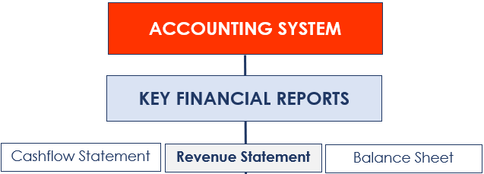
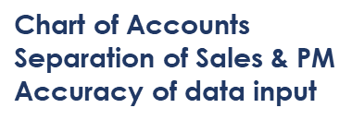
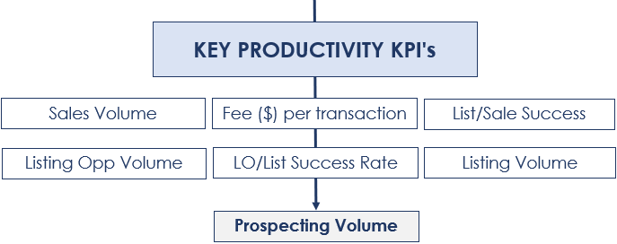
THE REAL ESTATE sales BUSINESS
Notes:
The Accounting System forms the foundation of the business measurement system. Emphasis is on the setting up of an appropriate Chart of Accounts, the separation of sales and property management revenue & expenses, and the need for the accurate input of data to the correct accounts (this is discussed later). Click through to the Key Financial Reports and discuss – note that emphasis will be on the Revenue Statement. Then click through to the Key Financial KPI’s and briefly discuss (detailed discussion later in the presentation), then click through to the Key Productivity KPI’s and briefly discussed (detailed discussion later in the presentation).

Slide 10

REAL ESTATE sales BUSINESS
The biggest impediment to successful financial management
Incorrect structure of the
Revenue (Profit & Loss) Statement
Notes:
Laser focus only on the things you can control.

Slide 11
REVENUE (p&l) STATEMENT: SEPERATION OF ACCOUNTS
Gross Profit margin?
If the expense is still incurred after the disposal of the Property Management business, then allocate the expense 100% to the Sales Business.
Notes:
Showing a Revenue (P&L) Statement that has combined both sales and property management revenue and expenses, then the effect of separation. Discussion emphasises that the accounting system must be set up to enable extraction of separate reports (or run separate accounting systems for each). Discussion on the need to apportion some payments at the time of ‘posting’ to ledger accounts – for example, rent may be apportioned 50% to the ‘Sales – Rent’ ledger and 50% to the ‘Property Management –Rent’ ledger.

Slide 12

FINANCIAL KPI (SALES BUSINESS): gross profit margin
Why is the Gross Profit Margin so important?
“If gross margins are just 20%, for every $10,000 increase in operational costs (rent, admin costs etc., fee revenue needs to increase by $50,000 just to maintain the same level of profit (or loss!)”
Notes:
The implication of the Gross Profit Margin

Slide 13


FINANCIAL KPI (SALES BUSINESS): gross profit margin
COST OF SALES (variable inputs)
Any cost directly related to the generation of a listing or sale – these costs increase or decrease with the volume of GSC:
Sales staff remuneration
Sales assistants/associates
Property advertising over-runs
Affiliation fees
Gifts to clients
OPERATIONAL EXPENSES (fixed expenses)
General operating overheads:
Office accommodation
Administration staff
Accounting & legal
Communication costs
Marketing & Promotion
etc…..

Slide 14

FINANCIAL KPI (SALES BUSINESS): gross profit margin
#Total cost of property advertising (online, print, signs, social etc)
less proportion paid by sellers
Notes:
Shows the correct structure of the real estate agency Sales business Revenue (P&L) Statement – discuss the critical implications, particularly the correct calculation of the Gross Profit Margin – FOR EXAMPLE, INCORRECT POSTING OF EXPENSES (PROPERTY ADVERTISING POSTED AS MARKETING)

Slide 15
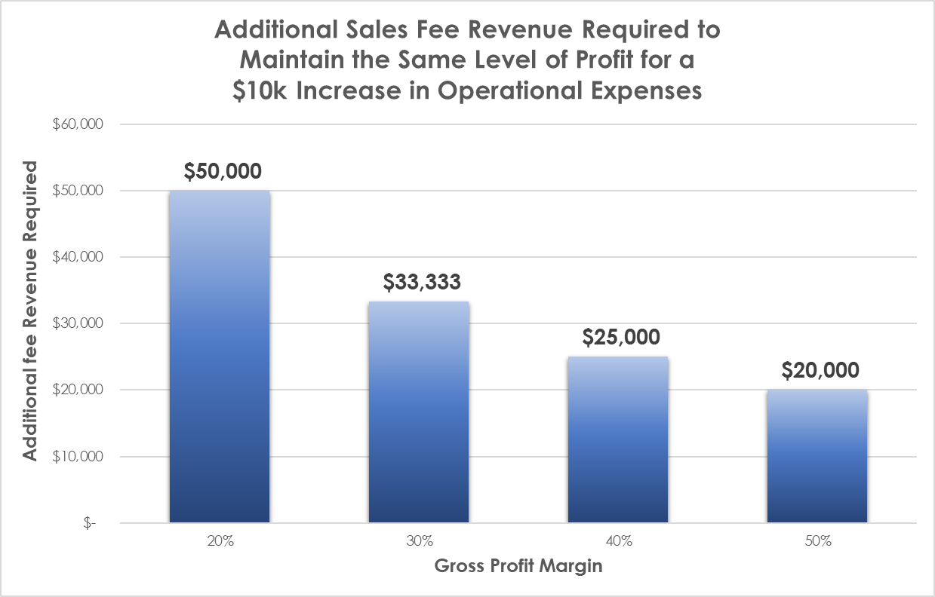
FINANCIAL KPI (SALES BUSINESS): gross profit margin

Slide 16
FINANCIAL KPI (SALES BUSINESS): gross profit margin
BASE SCENARIO
FRANCHISE FEE (5%) DEDUCTED BEFORE CALCULATION OF S/P ‘SPLIT’
*
*55% Comm on GSC + Super (9.5%) + WPI (0.5%)
FILE/ADMIN FEE $500 PER LISTING COLLECTED
100% PROPERTY ADVERTISING
COSTS RECOUPED
Notes:
Things that effect the Gross Profit Margin

Slide 17

FINANCIAL KPI (SALES BUSINESS): PROFIT CAPACITY
PROFIT CAPACITY
The maximum profit margin the business can achieve within its current cost structure….
The earning capacity and remuneration structure of the current sales team
Other Cost of Sales
Operational Costs

Slide 18

FINANCIAL KPI (SALES BUSINESS): BREAK-EVEN POINT
When Fee Revenue exactly covers all costs.

Slide 19

FINANCIAL KPI (SALES BUSINESS): BREAK-EVEN POINT
Why is the Business Break-Even Point so important?
Average GSC ($) per transaction |  |  | $14,000
 |  |  | No. Sales Required
Sales Fee Revenue | $ 880,000 | (BEP) | 63
Cost of Sales (75%) | $ 660,000
Gross Profit (25%) | $ 220,000
Fixed Costs | $ 220,000
Net Profit/Loss | $ -
Sales Fee Revenue | $ 550,000 | (BEP) | 39
Cost of Sales (60%) | $ 330,000
Gross Profit (40%) | $ 220,000
Fixed Costs | $ 220,000
Net Profit/Loss | $ -
Notes:
The BEP for a business showing a Gross Profit Margin of 40% is significantly less than one with a GP Margin of 25% - the 25% margin business must generate an additional $330,000 (or 24 sales at $15,000 comm per transaction) to achieve the same result. Furthermore, for a turnover of $1,200,000, the business with the higher GP Margin realises $180,000 more net profit than the other. ITS ABOUT THE LISTING AND SALES EFFORT REQUIRED TO ACHIEVE THE SAME RESULT!!

Slide 20
FINANCIAL KPI (SALES BUSINESS): BREAK-EVEN POINT
Why is the Business Break-Even Point so important?
Fewer Listings and Sales for the same Net Profit result
The lower the Gross Profit Margin, the higher the loss to the ‘bottom line’ for every dollar under the BEP
Notes:
The business with a GP of 25% breaks even at $880,000 – the business with the GP of 40% makes a net profit of $132,000 for the same turnover.

Slide 21

FINANCIAL KPI (SALES BUSINESS): BREAK-EVEN POINT
ACCOUNTING FOR THE AGENCY OWNERS INPUT
The ‘true’ Break-Even Point of the business should account for the owners input of time and expertise. Otherwise, the business owner is not being adequately compensated for personal ‘opportunity cost’.
Consider the owner as an employee of the business when modelling the Break-Even Point
Notes:
For example, a business showing a Net Profit of $250,000 for a $1M turnover may be considered a reasonable result. But not if the owner generated $400k of the sales fee revenue and spent 30 hours a week managing the business.

Slide 22
FINANCIAL KPI (SALES BUSINESS): BREAK-EVEN POINT
Theoretical model for the purpose of calculating the Break Even Point accounting for ‘adequate compensation to the ‘selling & managing’ agency owner.
Actual distribution (wages or dividends) to the owner will be dependent on professional taxation advice.
Notes:
Hypothetical Revenue Statement showing an allowance for ‘adequate compensation’ to the business owner working ‘in’ and ‘on’ the business.

Slide 23
COMBINED EFFECT OF GROSS PROFIT MARGIN & AVERAGE SALE FEE
Notes:
Shows the variation in sales activity output for varying combinations of Gross Profit Margin and Average Fee ($) per transaction required to achieve the same Net Profit Margin as the BENCHMARK SCENARIO

Slide 24
COMBINED EFFECT OF GROSS PROFIT MARGIN & AVERAGE SALE FEE
It’s not just about Market Share!
Notes:
Shows the variation in sales activity output for varying combinations of Gross Profit Margin and Average Fee ($) per transaction required to achieve the same Net Profit Margin as the BENCHMARK SCENARIO

Slide 25

salespersons break-even point
The point at which gross fee revenue generated by the salesperson exactly covers all the salespersons costs: -
The salespersons total employment costs, and
The salespersons ‘desk cost’
¹Including the ‘selling’ business owner
²Salespersons total employment costs as a % of gross fee revenue generated by the S/P.
Notes:
The Salespersons Break-Even Point is important for 2 reasons. 1. It establishes the point at which the business starts to make a profit from the salespersons listing and sales activity (or a loss) 2. It is an efficiency measure, highlighting whether the operational costs are appropriate for the size of the team - for example, operational costs of $250,000 for a sales team of 3 would suggest that there is an excess of resource whereas, the same operational costs for a sales team of 6 indicates a more effective use of resources.

Slide 26
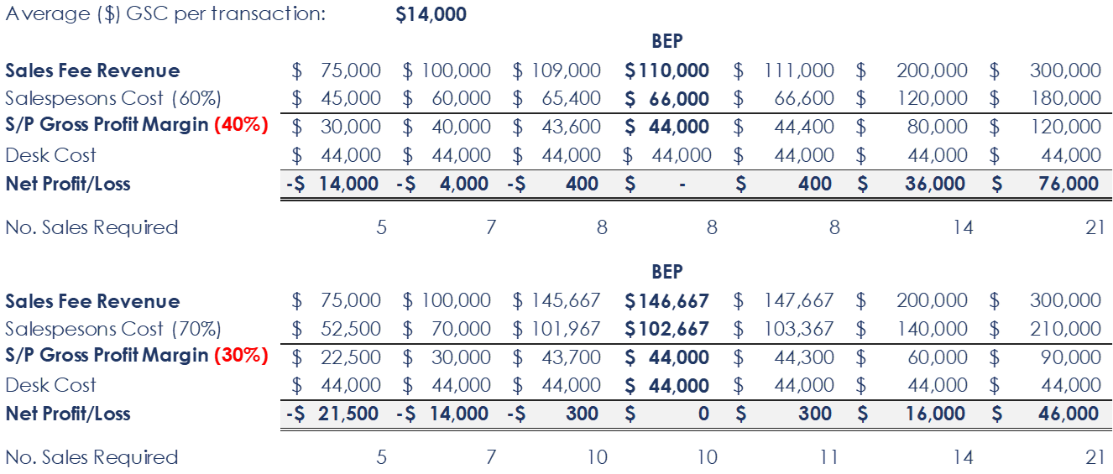

salespersons break-even point
Why is the Salespersons Break-Even Point so important?
Fewer Listings and Sales for the same Net Profit result
The lower the Gross Profit Margin, the higher the loss to the ‘bottom line’ for every dollar under the BEP
Notes:
As with the agency Break-Even Point review, it is clear to see that the BEP for the lower salesperson ‘cost’ is significantly lower than for the higher cost scenario. Either side of the BEP example for each, it can be seen the Net Loss for the business for each $1,000 shortfall the BEP. For example, the new Real Estate Salespersons Award dictates that the busines cannot have a number of casual ‘commission only’ people in the business if they are not settling over their BEP – otherwise they are costing the business.

Slide 27
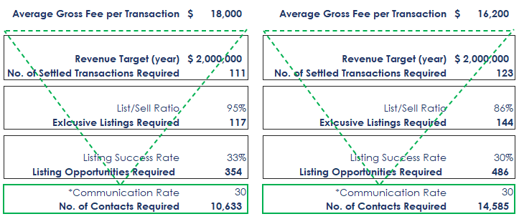
SALES EFFICIENCY KPI’s - LISTING & SALES ACTIVITY
AGENCY (ALL)
Outcome for a 10% fall-off in all performance indicators
*The volume of meaningful contacts with past & established clients, spheres of influence
and through the marketing & prospecting effort designed to attract new clients
Notes:
Showing the effect of a 10% fall off in the Key Productivity Measures for the business. The ‘work rate’ required to generate the same revenue is significantly higher in the second scenario. Highlights the need to monitor these statistics, recruit the right people, and take corrective action such as – monitoring the prosecting effort volume, training sales staff to improve their productivity indicators and/or managing out underperforming salespeople. A salesperson who ‘burns’ 5 out of 6 listing opportunities perhaps should not be in the business.

Slide 28
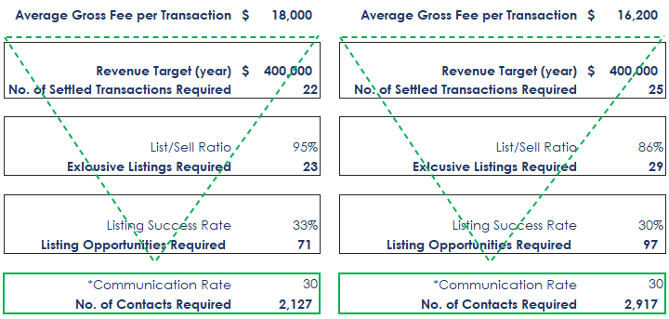
SALES EFFICIENCY KPI’s - LISTING & SALES ACTIVITY
Outcome for a 10% fall-off in all performance indicators
SALESPERSON
*The volume of meaningful contacts with past & established clients, spheres of influence
and through the marketing & prospecting effort designed to attract new clients
Notes:
Showing the effect of a 10% fall off in the Key Productivity Measures for the business. The ‘work rate’ required to generate the same revenue is significantly higher in the second scenario. Highlights the need to monitor these statistics, recruit the right people, and take corrective action such as – monitoring the prosecting effort volume, training sales staff to improve their productivity indicators and/or managing out underperforming salespeople. A salesperson who ‘burns’ 5 out of 6 listing opportunities perhaps should not be in the business.

Slide 29
RESIDENTIAL PROPERTY MANAGEMENT BUSINESS
ONE MANAGEMENT ASSET: REVENUE | COSTS | ASSET VALUE
PM OPERATIVE
COSTS
ADVERTISING
OVER-RUNS
COSTS OF SALE
OPERATING EXPENSES
NET PROFIT
ASSET
VALUE
LOAN EXPENSE
MOTOR VEHICLE COSTS
FEE REVENUE
NEW MANAGEMENT
ORGANIC GROWTH
NEW MANAGEMENT
PURCHASED
ACQUISITION COST
Notes:
The purpose of this slide is to provide a simplified overview of the business of property management by looking at life cycle of acquisition, revenue capacity of the management and the allocation of expenses from revenue leaving a margin of profit – and an asset of value.

Slide 30
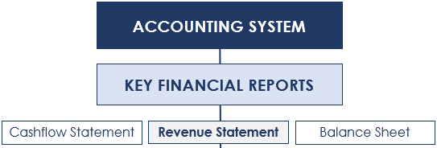

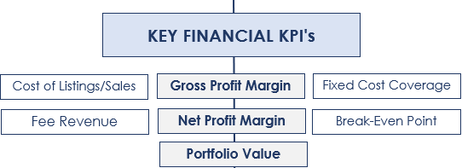
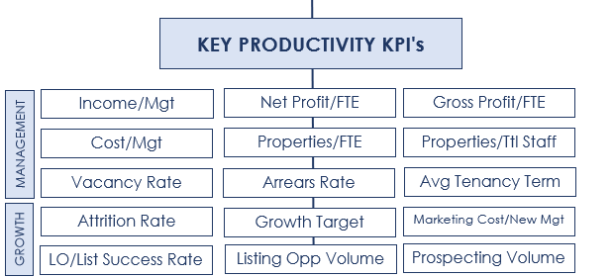
RESIDENTIAL PROPERTY MANAGEMENT BUSINESS
FTE
(full time equivalent)
Directly involved in managing or listing.
Property Managers
New Business Managers
Leasing
Inspections
Notes:
The Accounting System forms the foundation of the business measurement system. Emphasis is on the setting up of an appropriate Chart of Accounts, the separation of sales and property management revenue & expenses, and the need for the accurate input of data to the correct accounts (unchecked and ongoing incorrect posting of revenue and expenses may lead to significant distortions in outputs). Click through to the Key Financial Reports and discuss – note that emphasis will be on the Revenue Statement. Click through to the Key Financial KPI’s and briefly discuss (detailed discussion later in the presentation), then click through to the Key Productivity KPI’s and briefly discuss.

Slide 31
The revenue (P&L) statement- PROPERTY MANAGEMENT
¹Directly involved in managing, leasing
or new business acquisition.
Property Managers
New Business Managers
Leasing
Inspections
Notes:
Shows the correct structure of the real estate Property Management business Revenue (P&L) Statement – discuss the critical implications, particularly the correct calculation of the Gross Profit Margin.

Slide 32
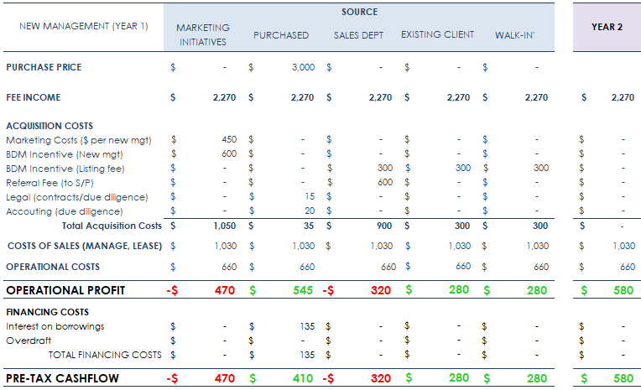
ANATOMY OF A NEW MANAGEMENT (yEAr 1)
WHICH GROWTH STRATEGY?
Notes:
Examining the financial implications of acquisition with emphasis on leveraging through borrowing to acquire.

Slide 33
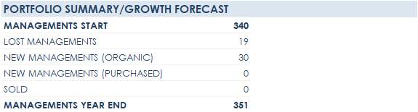
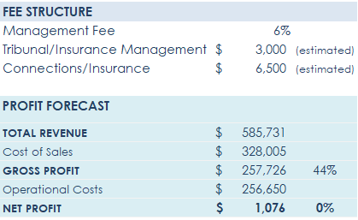
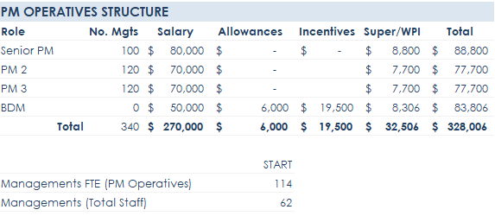
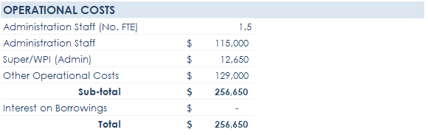
OPPORTUNITIES FOR IMPROVED PROFIT
ORIGINAL SCENARIO
(Inefficient Staffing Structure/Low Fee Structure)
Notes:
Case study/scenario analysis. Review the current Profit Status of the business by clicking through and discussing the Portfolio Summary/Growth Forecast, PM Operative Structure and Operations Costs sections - then click on the FEE STRUCTURE/PROFIT FORECAST section to highlight that overstaffing and a low fee structure mean the business is not profitable in its current state.

Slide 34
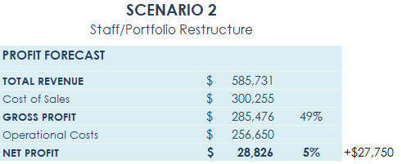
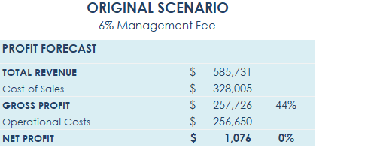

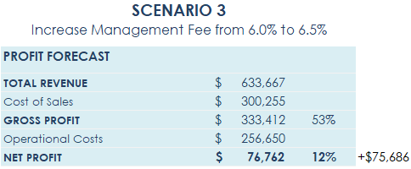
OPPORTUNITIES FOR IMPROVED PROFIT
Notes:
The Original Scenario PROFIT FORECAST is replicated as the base scenario. Scenario 2 demonstrates the improved profit margin by re-structuring property management staff. The ROI on a standalone new business manager is often questionable – combining the role of BDM and PM could be a solution, however, we must consider that the personality types and skill set for each role is different (sales orientated v administration orientation).

Slide 35
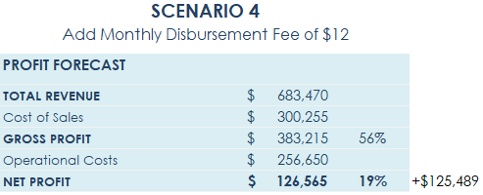
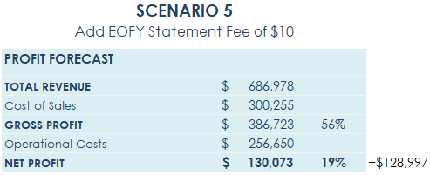
OPPORTUNITIES FOR IMPROVED PROFIT
Notes:
Obviously, increasing fees will improve the bottom line – of course, this is easier said than done. The examples are provided as theoretical demonstrations of the improved profit margins for variation in fee structure. While increasing management fees is likely to bring strong resistance, the addition of a small monthly fee produces significant profit improvement without un-nerving the landlord. THE BUSINESS OWNER HAS 2 CHOICES – ACCEPT THE CURRENT PROFIT (OR LOSS) STATUS OF THE BUSINESS, OR TAKE ACTION (AND ACCEPT THE RISK) TO IMPROVE IT .

Slide 36
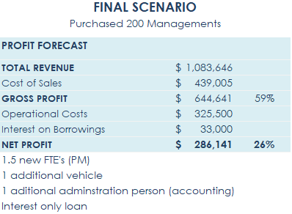
OPPORTUNITIES FOR IMPROVED PROFIT
Financial Leveraging
Notes:
The Final Scenario shows the advantages (increase profitability) of borrowing to acquire managements by leveraging the existing infrastructure.

Slide 37
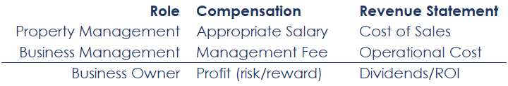
business break-even point
KEY FINANCIAL KPI’s
ACCOUNTING FOR THE AGENCY OWNERS INPUT
Profitability analysis should account for the owners input of time and expertise. Otherwise, the business owner is not being adequately compensated for personal ‘opportunity cost’.
Notes:
Business Owners/Managers who are actively involved in the property management business should account for their input if the true level of profitability is to be established – if the role was not being fulfilled by the owner, it would have to fulfilled by someone else (who will need to be paid!).

Slide 38
PLAN OF ACTION: PROPERTY MANAGEMENT
Restructure the Chart of Accounts & Revenue Statement
Separate Sales and Property Management revenue and expenses
Calculate the current Profit status of the business and carry out scenario analysis to identify opportunities for increase profit (agentprofitplanner)
Review & Reduce Cost of Sales
Review PM Operatives job roles (clarity, productivity & efficiency)
Review salary and incentive structure
Review systems and processes (opportunity for efficiency gains?)
Eliminate advertising over-runs
Identify other ‘road-blocks’ (independent review?)
Review BDM and new business marketing costs (ROI satisfactory?)
Review and Reduce Operational Costs
Review admin staff roles and productivity
Review loans and overdraft facility
Review and reduce subscription costs
Office accommodation costs
Review insurance costs
Finalise Plan of Action to support the achievement of Financial Targets
Engage a ‘third eye’
Involve your team
Notes:
Review the suggested POA.

Slide 39
PLAN OF ACTION: SALES
Restructure the Chart of Accounts & Revenue Statement
Calculate current Break-Even Point and Profit Capacity (agentprofitplanner)
Review & Reduce Cost of Sales
Remove underperforming sales staff
Recruit sales staff
Renegotiate sales commission rates (tiered structure/bonus)
Eliminate advertising over-runs
Review cost/productivity of sale assistants
Increase listing/file admin fee
Review and Reduce Operational Costs
Review admin staff roles and productivity
Review loans and overdraft facility
Review and reduce subscription costs
Office accommodation costs
Review insurance costs
Construct Financial and Sales Activity Targets for the year ahead (agentprofitplanner)
Finalise Plan of Action to support the achievement of Financial Targets
Engage a ‘third eye’
Involve your team
Notes:
Showing the effect of a 10% fall off in the Key Productivity Measures for the business. The ‘work rate’ required to generate the same revenue is significantly higher in the second scenario. Highlights the need to monitor these statistics, recruit the right people, and take corrective action such as – monitoring the prosecting effort volume, training sales staff to improve their productivity indicators and/or managing out underperforming salespeople. A salesperson who ‘burns’ 5 out of 6 listing opportunities perhaps should not be in the business.

Slide 40
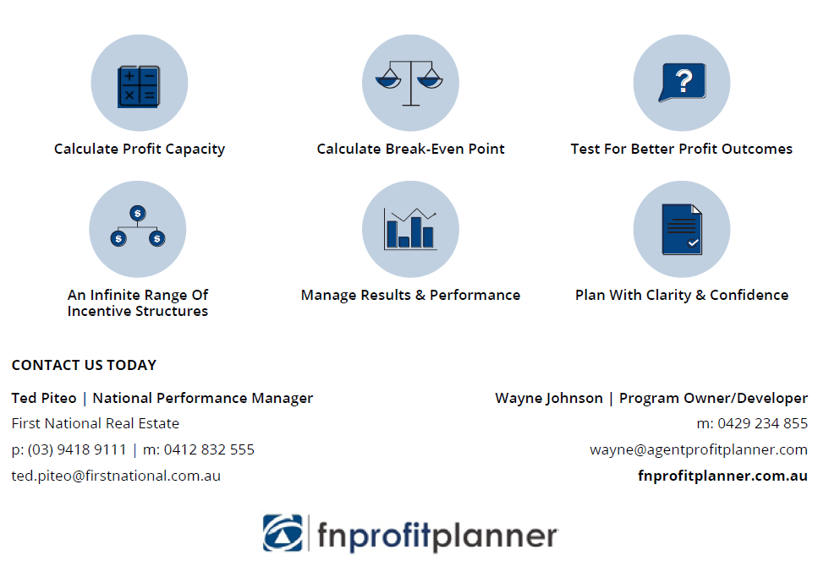
So, how can fnprofitplanner help you…..

